Slide 1

Harmonizing Data for Social Determinants of Health
DEVELOPMENT OF FHIR BASED API FOR SDOH DATA EXCHANGE
Health Disparities Codeathon
June 24, 2021
Tara Swelstad, James Burroughs, Ayomide Owoyemi, Julia Gichimu

Slide 2
Background
Social determinants of health are gaining increased recognition as significant factors that influence healthcare outcomes for different patients.
The number of deaths attributable to education, racial segregation, and low social support are comparable to deaths due to myocardial infarction, cerebrovascular disease, and lung cancer.
This has led to increased attention on the collection and coding of SDOH data in the EHRs to support care.

Slide 3
Objectives
AIM 1:
Build a provider facing app that will allow the access, use, and analysis of data ingested through FHIR. Present EHR data in a way that’s useful and actionable
AIM 2:
Use EHR record output from aim 1 to define risk indicators for homelessness and substance abuse.

Slide 4
Fast Health Interoperability Resources (FHIR)
Patients see multiple providers in different health systems using different EHRs
FHIR is used to exchange data between EHRs and has been adopted by other big technology companies to standardize health data exchange
Creates a single health record by integrating data from multiple EHRs
FHIR allows developers to create apps that can feed information into a provider’s workflow – the clinician doesn’t have to go to multiple places to look at patient data.

Slide 5
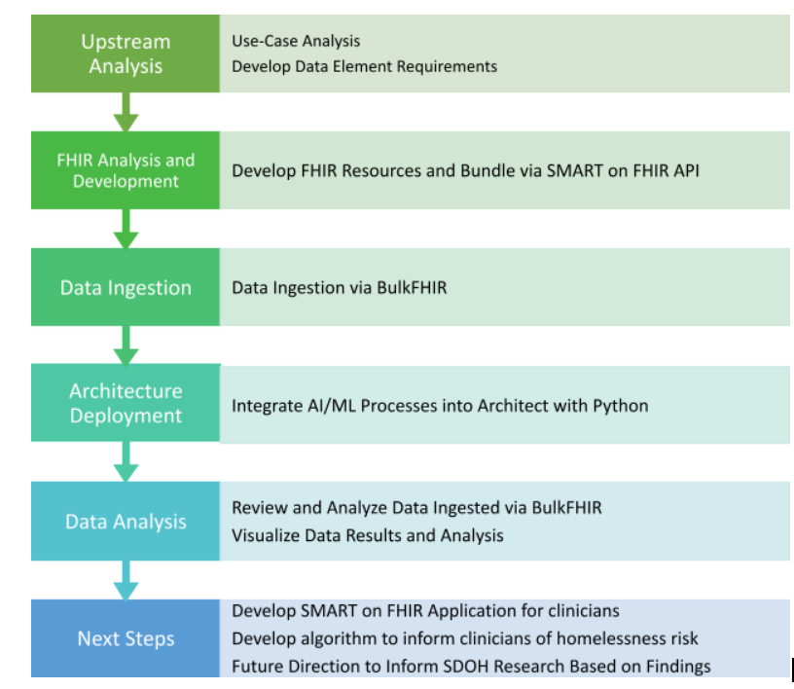
Workflow

Slide 6
Develop Data Elements Requirement
Demographics
Date of Birth
Place of Birth
Gender
Military Service (VeteranStatus)
Race
Ethnicity
City
State
postalCode
EducationLevel
employmentStatus
usualWork (Occupation and Industry)
Income
BodyHeight
Weight
disability
Health Insuarance Coverage (plan)
Lab Results
Buprenorphine
Fentanyl
Heroin Metabolite
Opiates
Tapentadol
Tramadol
Drug of Abuse panel
Homeless
Transitional Housing
No Home
Homeless/Shelter
Mental Health Illnesses
Depression
Schizophrenia
PTSD
Bi-Polar
Alcohol abuse
Suicide

Slide 7
FHIR Analysis and Development/ Data Ingestion
[INPUT INFO on how Tara was getting the data]
Providers collecting Social Determinants of health data elements are inconsistent.
The data is sparce, missing many of the elements we defined

Slide 8
Future Directions
Identify
Identify appropriate data sets and sources that contain robustness and inclusivity
Ingest
Ingest the data into a AI/ML pipeline, perform QC analysis, and ETLs
Validate
Validate the AI/ML model for homelessness and substance use risk prediction

Slide 9
Roles and Responsibilities
Tara Swelstad – Team Leader and FHIR Guru
James Burroughs – Co-PI (Research Framework and Writer)
Ayomide Owoyemi – Co-PI (Research Framework and Writer)
Julia Gichimu – SysAdmin and Data Analysis (R Python Guru)
Mvuyo Makhasi – Data Engineer and Architect

